Slide 1
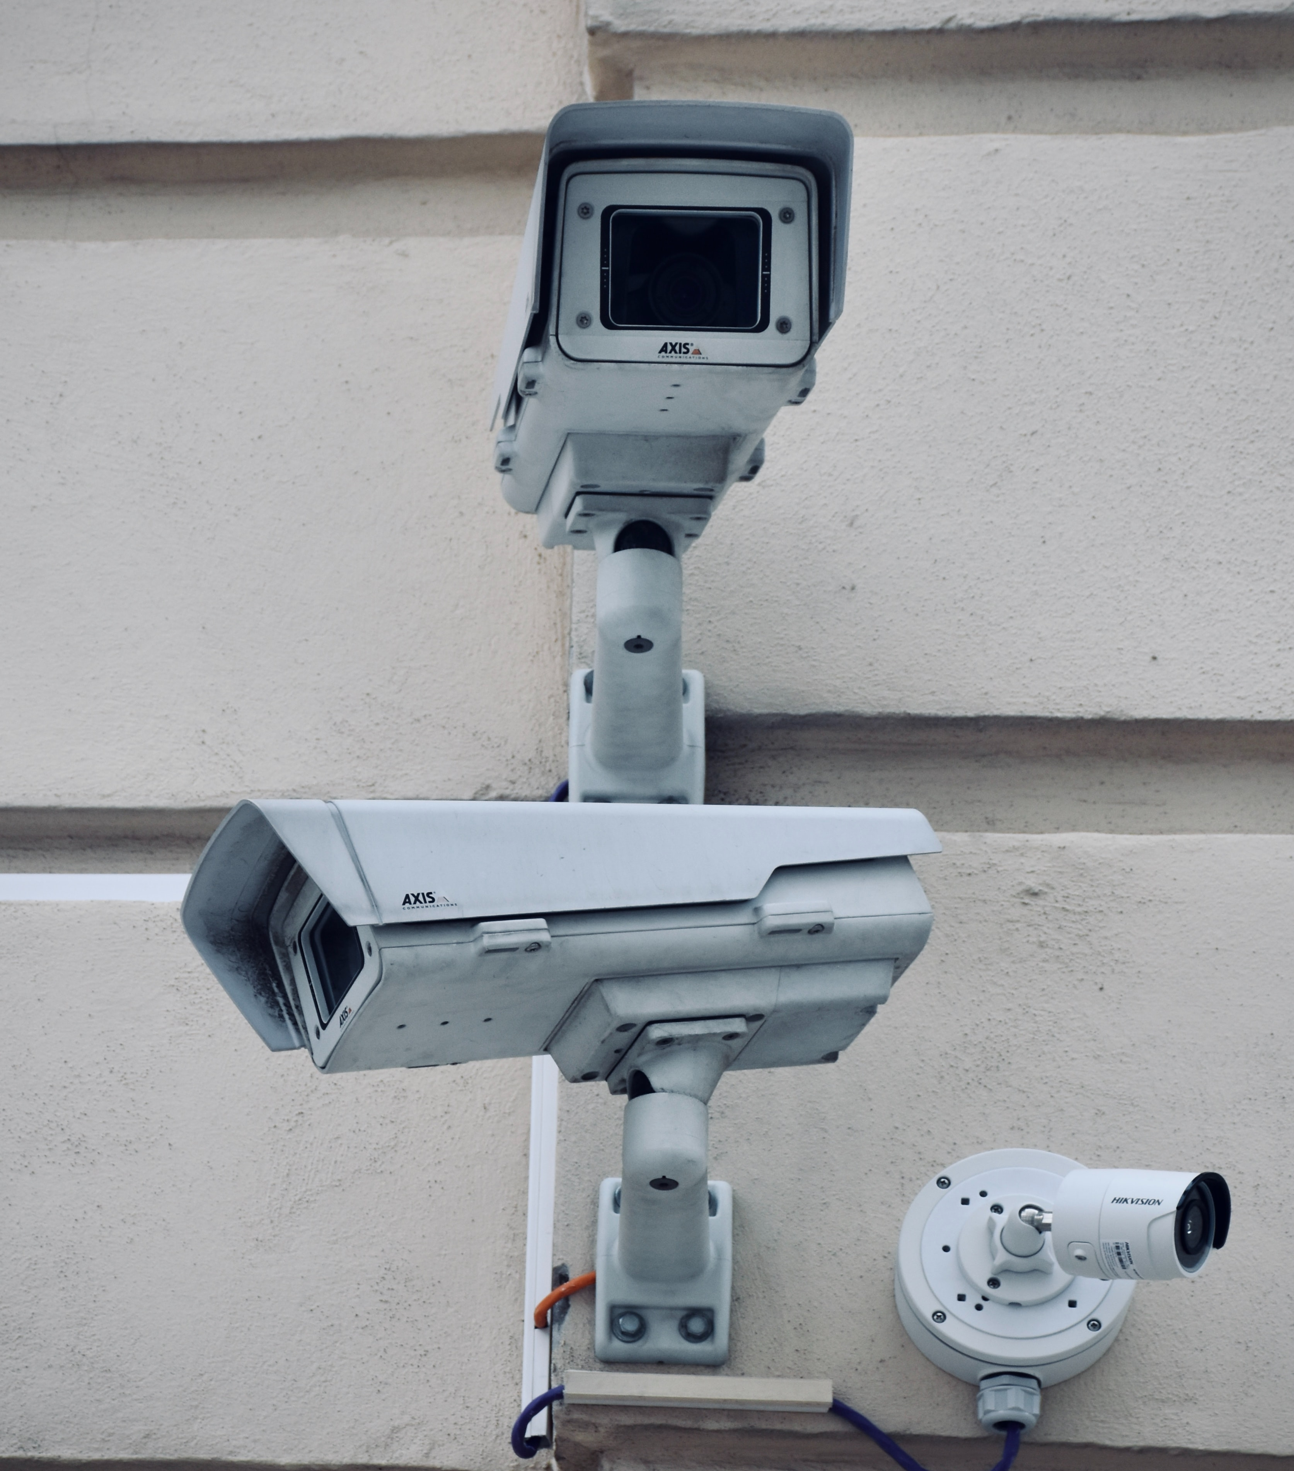
Security Expert System
Submitted By :
Mostafa Hamwi
Aeham Al-Khatib
Anas Qimah
Supervised By :
Dr. Waed Khwies

Slide 2

Outline
Project Scope
Project Phases
Analysis
Implementation
Output Cases
Decision Tree
Project Specialties
Difficulties
Future Work

Slide 3
Project Scope
Our Security Expert System is designed to provide organizations with the most suitable security measurements based on organization assets such as network, building and data .
The aim for this project is to save you the effort required for hiring security consultants and minimize miscalculations caused by humans.

Slide 4
Project Phases
Analysis :
The project went through many phases, the project was initially small, discussing only one case, and then it went bigger to cover other aspects of security and be useful for more people.

Slide 5
Project Phases
Implementation :
Draw.io for visual presentation (Block Diagram, Decision tree, etc…)
Python using Experta library for code implementation.

Slide 6
Decision Making
Our decisions were always in the users favor to make the process simpler and more adequate for non-professional users.

Slide 7
Output Cases
Output cases varies between a wide range of results that are dependent on user answers and the type of security that the user picked.

Slide 8
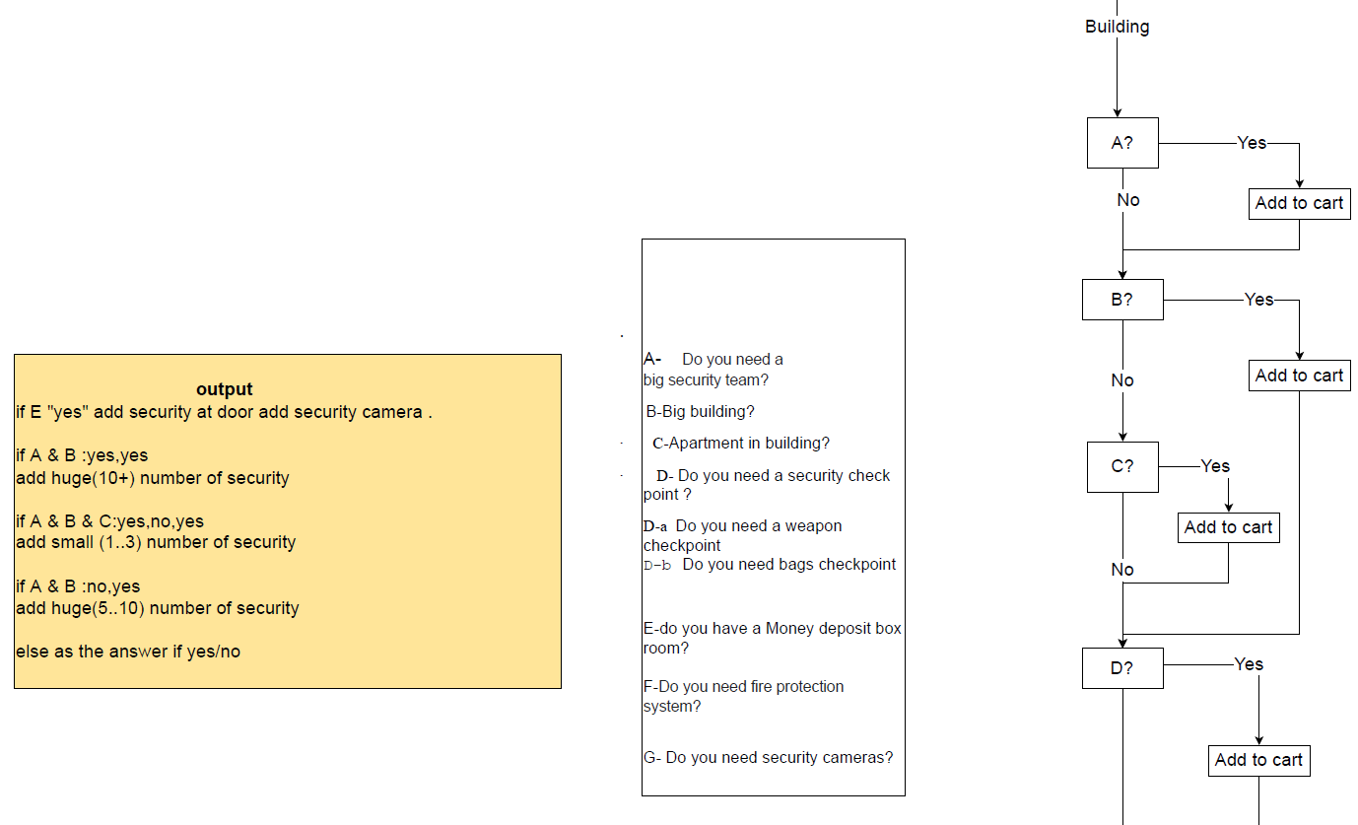
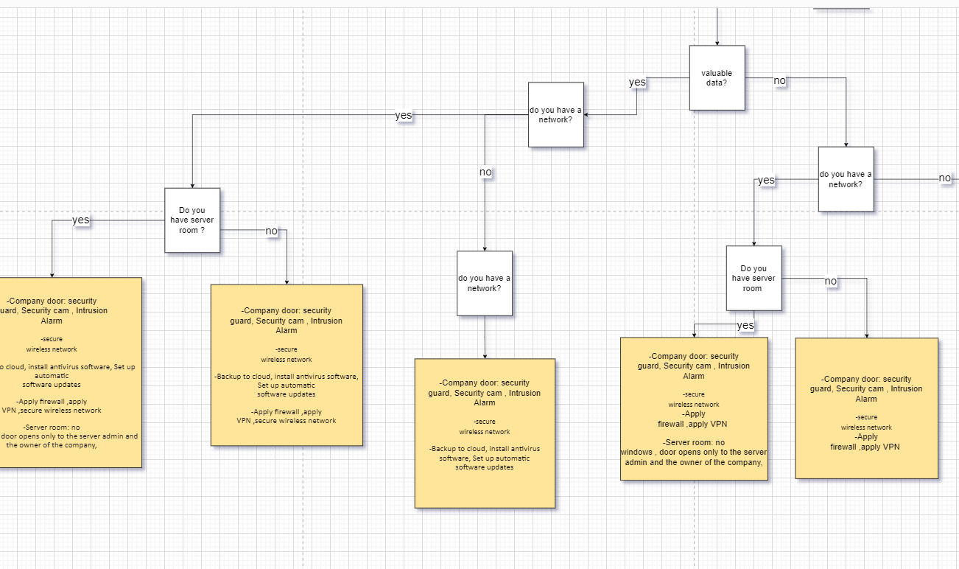
Decision Tree

Slide 9
Difficulties
Collecting, extracting the information.
The huge number of categories that need to be considered.
Simplifying the questions for the user.

Slide 10
Future Works
Covering all types of security in more detailed way.
Making a system for more advanced users.

Slide 11
References
https://cybersecurityguide.org/careers/security-consultant/
https://onlinedegrees.sandiego.edu/how-to-become-a-security-consultant-career-guide/

Slide 12

Thank You For Listening

